Slide 1

Mililani Town Association
Welcome New Homeowners!

Slide 2
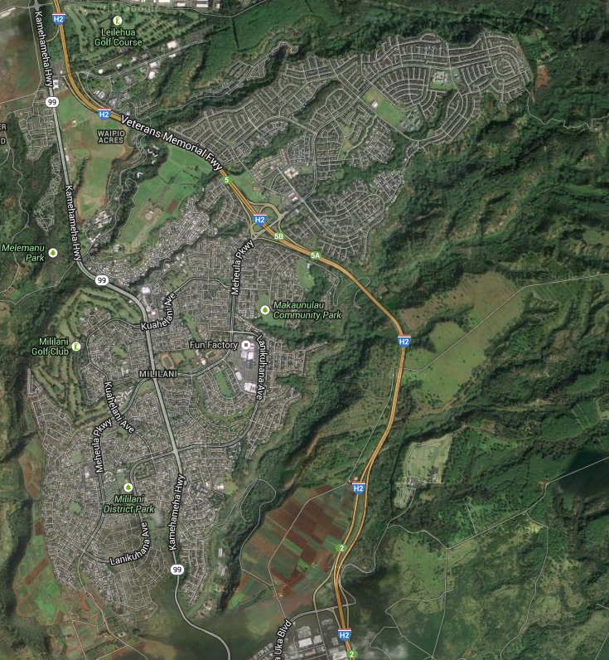
Mililani Town, Hawaii

Slide 3
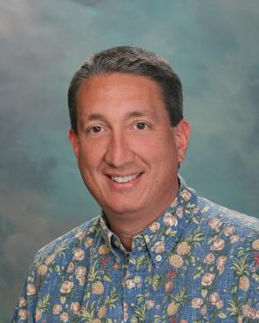
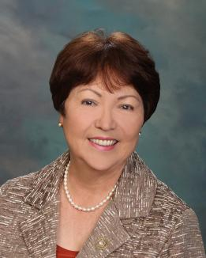
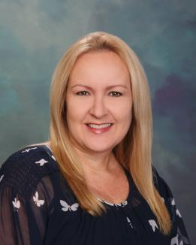
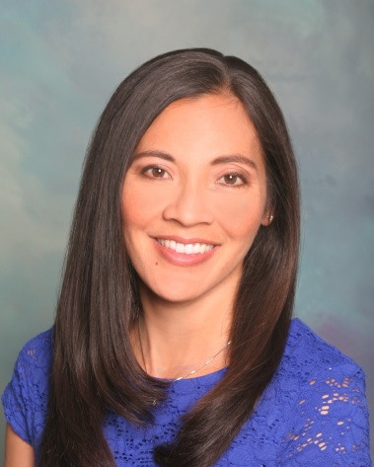
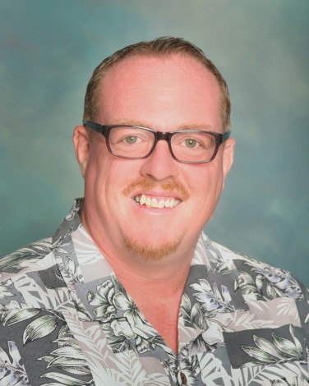
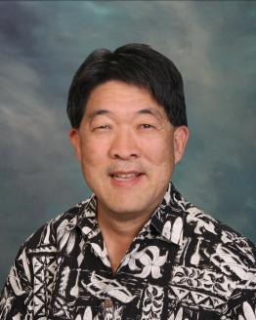
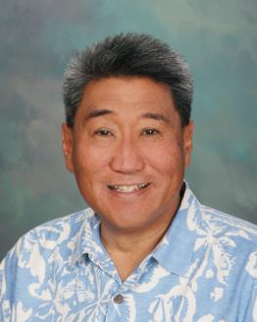
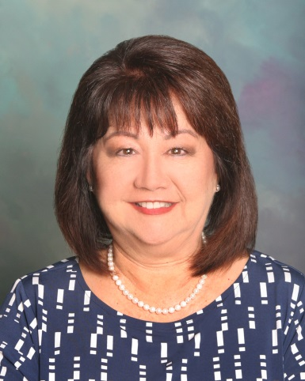

Board of Directors
Bob Barrett
President
Michelle Kidani
Vice President
Josie Ka’anehe
Secretary
Val Okimoto
Treasurer
Will Kane
Neil Takeda
Michael Magaoay
Noriko Salangdron
Roger Babcock
2020-2021

Slide 4
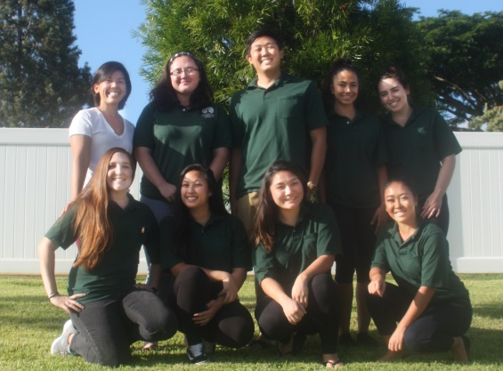
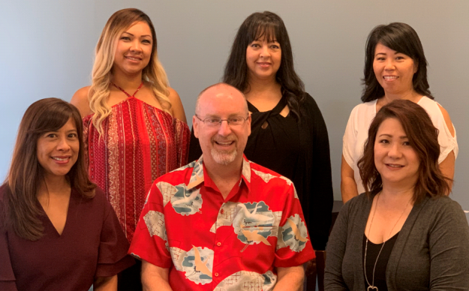
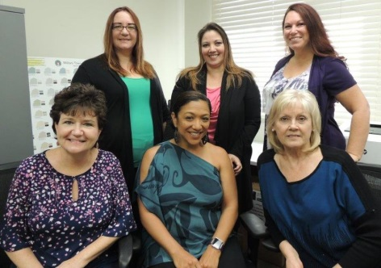
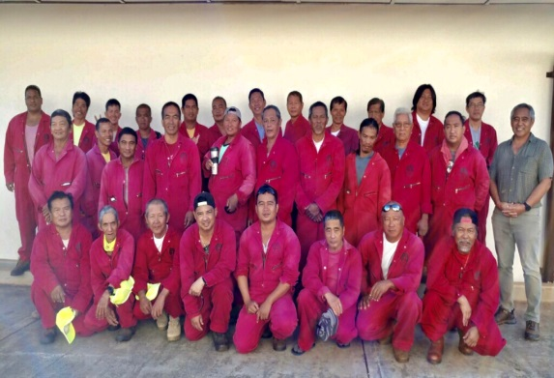
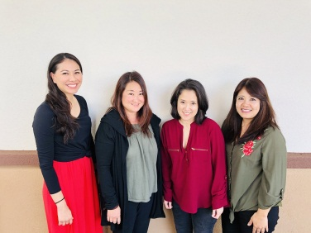
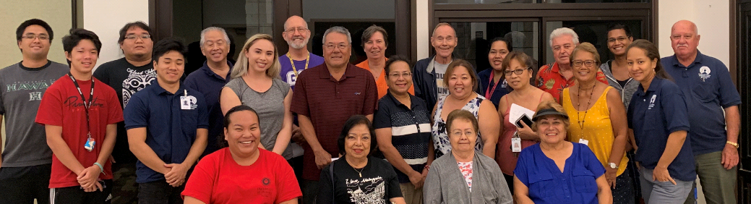
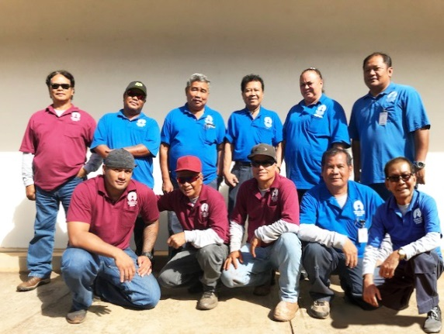
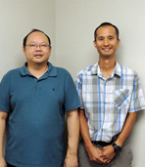
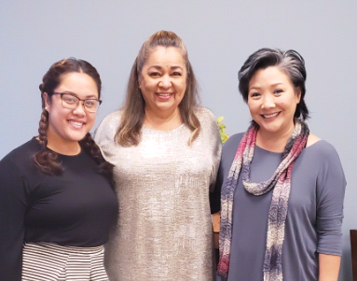
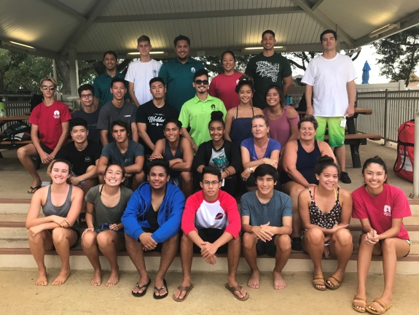
Association Staff
Admin
Covenants & Design
Cafe
Accounting
Common Area
Member Services
Information
Technology
Special Events
Utility
Aquatics

Slide 5
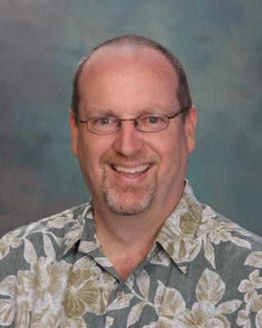
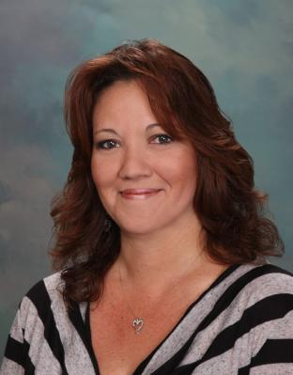
DAVID O’NEAL, PCAM, CMCA, AMS
General Manager
808-440-2614
doneal@mililanitown.org
“ I welcome any comments/suggestions. The management
team at MTA is here to help keep Mililani a great place to live!”
KATHERINE CUEVA, CMCA, AMS
Assistant General Manager
Covenants and Design Manager
808-440-2622
kcueva@mililanitown.org
Katherine is responsible for all questions and concerns regarding MTA Covenants and Design.

Slide 6
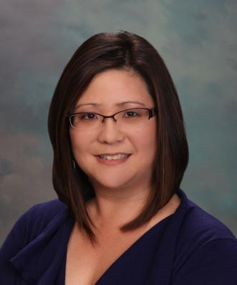
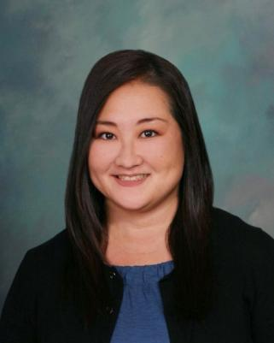
LAURIE USUI, CMCA, AMS
Member Services Manager
808-440-2626
lusui@mililanitown.org
Laurie is responsible for Member Services Coordinators, Special Events, Marketing, Newsletter, Facility Rentals, Meeting and Seminars, Membership, Tiny Tots and Senior Programs and Independent Contractors
LYNELLE TAMASHIRO, CPA, CMCA
Controller
808-440-2636
ltamashiro@mililanitown.org
Lynelle is responsible for maintenance assessments, accounts payable, accounts receivable, payroll and financials.

Slide 7
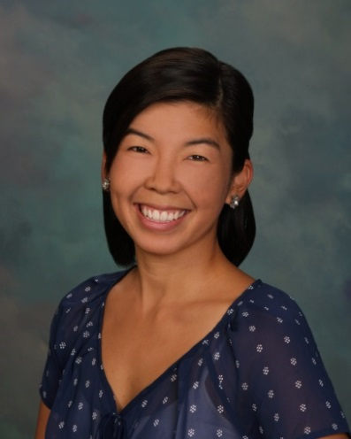
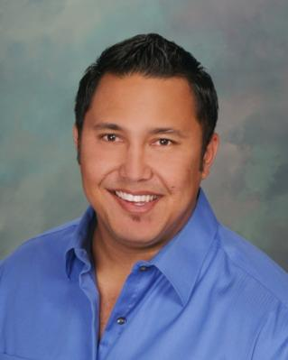
JESSICA MACLACHLAN
Café Manager
808-440-2653
jmaclachlan@mililanitown.org
Jessica is responsible for the day to day operations of the coffee facility located at Recreation Center 7.
KALEO PERREIRA, CPO
Aquatics and Safety Manager
808-440-2632
jperreira@mililanitown.org
Kaleo is responsible for pool schedules, swim lessons, aquatics programs and also oversees the company’s safety policies and procedures.

Slide 8
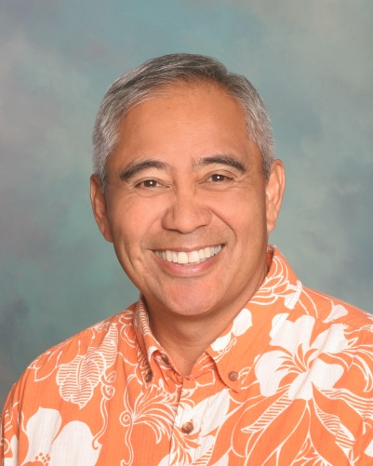
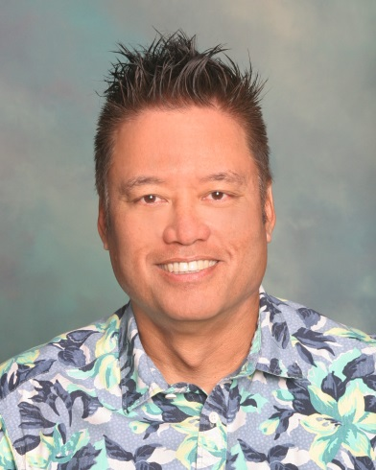
DARRYL BARBADILLO, ISA Certified Arborist
Landscaping Manager
808-440-2638
dbarbadillo@mililanitown.org
Darryl is responsible for all work involved in the maintenance of MTA’s landscaped common areas.
ROY TASHIRO, CPO
Maintenance Manager
808-440-2611
rtashiro@mililanitown.org
Roy is responsible for all the maintenance of MTA’s facilities.

Slide 9
Accounting
Accounts Receivable
Accounts Payable
Payroll
Ownership Changes

Slide 10
Quarterly Assessments
$125 per quarter (effective April 1, 2020)
Due 1st of every quarter January 1, April 1, July 1, October 1
Reminder statement sent approximately 2 weeks prior to the due date
  Only if there is a balance owing and not on Surepay

Slide 11
e-statements
pdf statement sent via email
How to enroll:
Go to www.mililanitown.org , e-statements link on the assessments page
Create an account using your Account Number and Street Number
An email will be sent with an activation link, click on and you are enrolled!

Slide 12
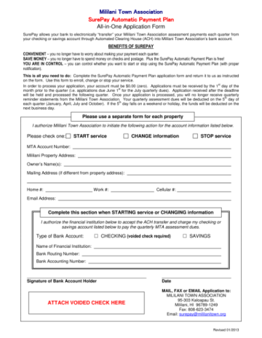

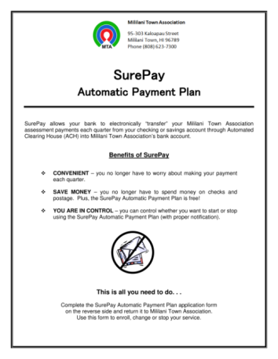

Paying Assessments
Quarterly Assessment and Payment Information
5 Ways to Pay!
Surepay
**In Person
**Secure Drop-Box
Mail
Online
** check our website for updates due to Covid-19

Slide 13
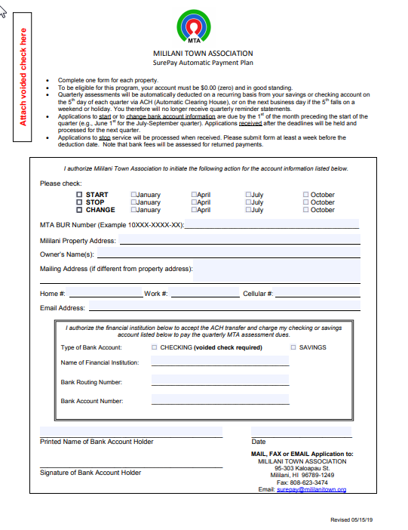
Surepay
Automatically withdraws quarterly assessments from a checking or savings account on the 5th following the due date
How to enroll:
Fill out an application and attach a voided check
Drop off, fax, mail or email applications

Slide 14
Pay Online
Make a one-time payment
Register and set up a profile to set up recurring, automatic or text2pay
Text and email notifications available
Pay with a credit card or checking account for no charge (credit or debit card recommended over a bank account)
Manage multiple properties in one account

Slide 15
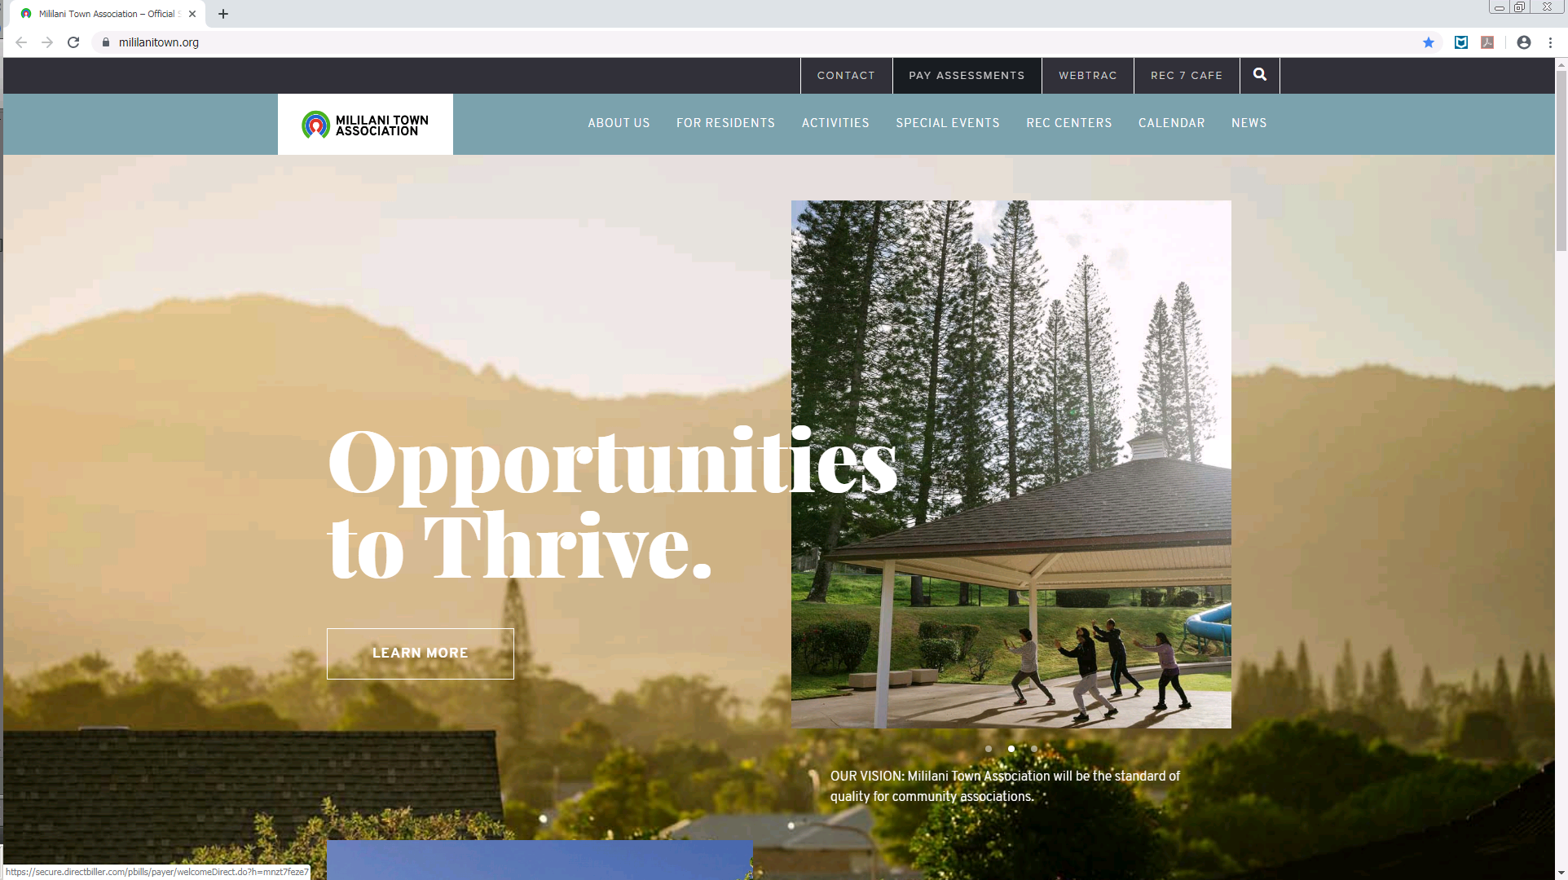
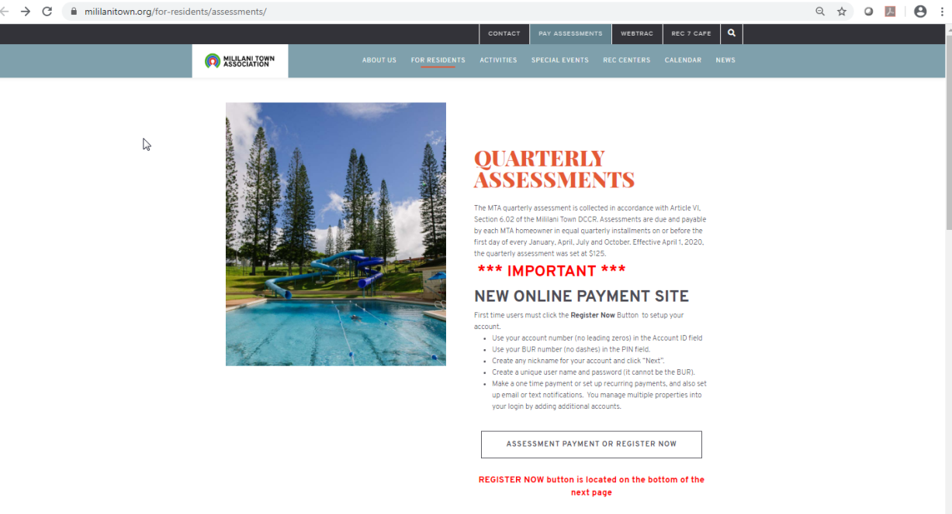
How to Pay Online
Go to www.mililanitown.org and click on the Pay Assessments link at the top, click the link on the next page to go to the sign in page

Slide 16
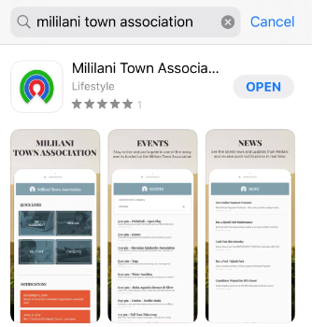
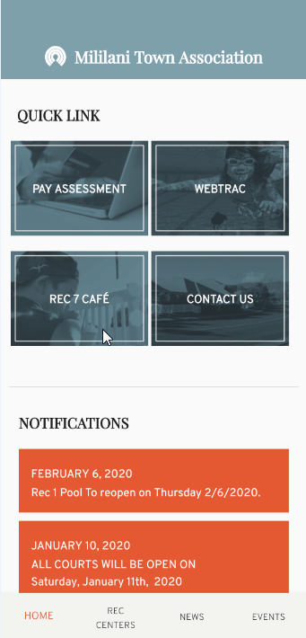
How to Pay Online cont.
Use the Mililani Town Association app to go to our website to pay assessments.

Slide 17
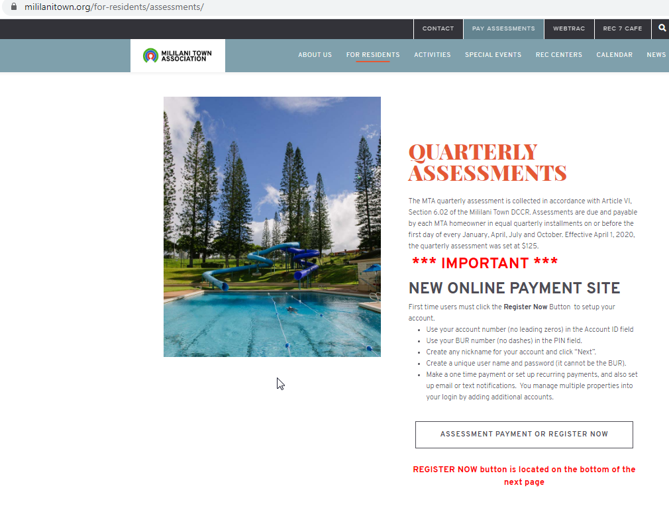
How to Pay Online cont.
On the quarterly assessments page, click the link to go to the sign in page

Slide 18
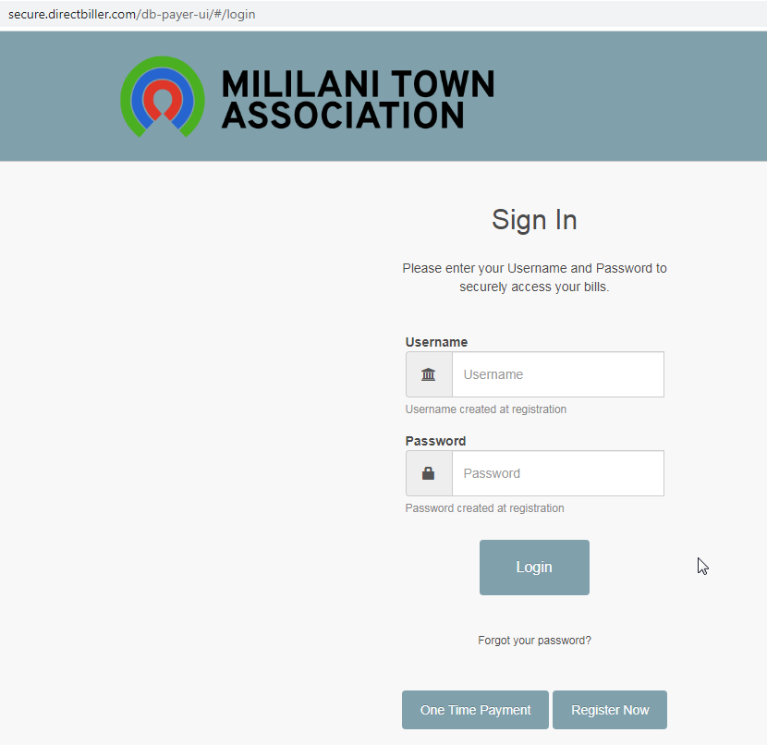
How to Pay Online cont.
Click “one-time payment” on the bottom left to make a one-time payment and not retain any credit card information
To retain credit card information for future use, new users should set up a profile by clicking “register now”
Use your 5-digit account number (no leading zeros) and 10-digit BUR number (no dashes) to make a one-time payment or set up your profile
Once registered you may put your username and password in the top portion of the sign in page

Slide 19


Covenants & Design
Enforcement of the Declaration of
Covenants, Conditions &
Restrictions.
*Covenants Specialists
*Covenant Inspectors
The Design Committee
Rules & Guidelines.
*Design Committee
*Design Specialists

Slide 20
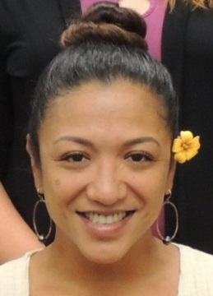

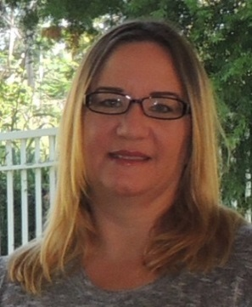
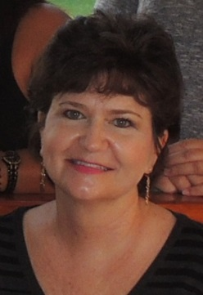
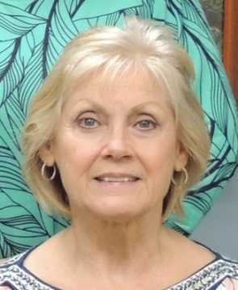
Covenants & Design Team
Kimmey Silva
Covenants Specialist
Lori Etter
Covenants Specialist
Deina Hendrickson
Covenants/Design Specialist
Tricia Balmilero
Member Relations Administrative Assistant
Janelle Drapesa
Design Specialist

Slide 21
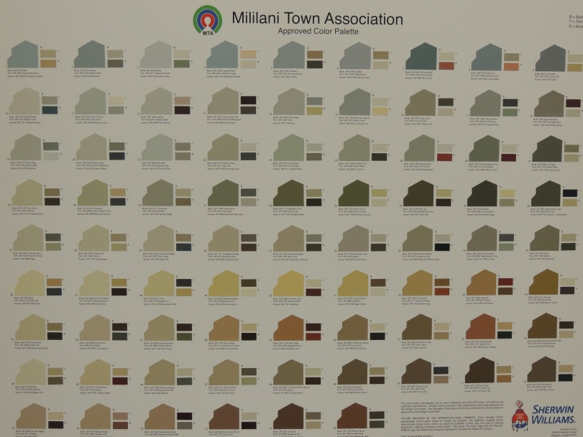
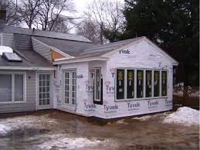

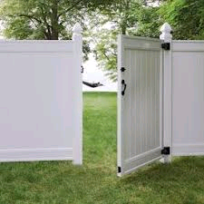

Common Applications
Basic Rule of Thumb is anything EXTERIOR will probably need an MTA Approval

Slide 22
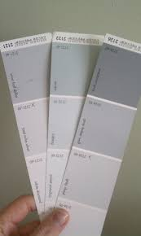


Slide 23
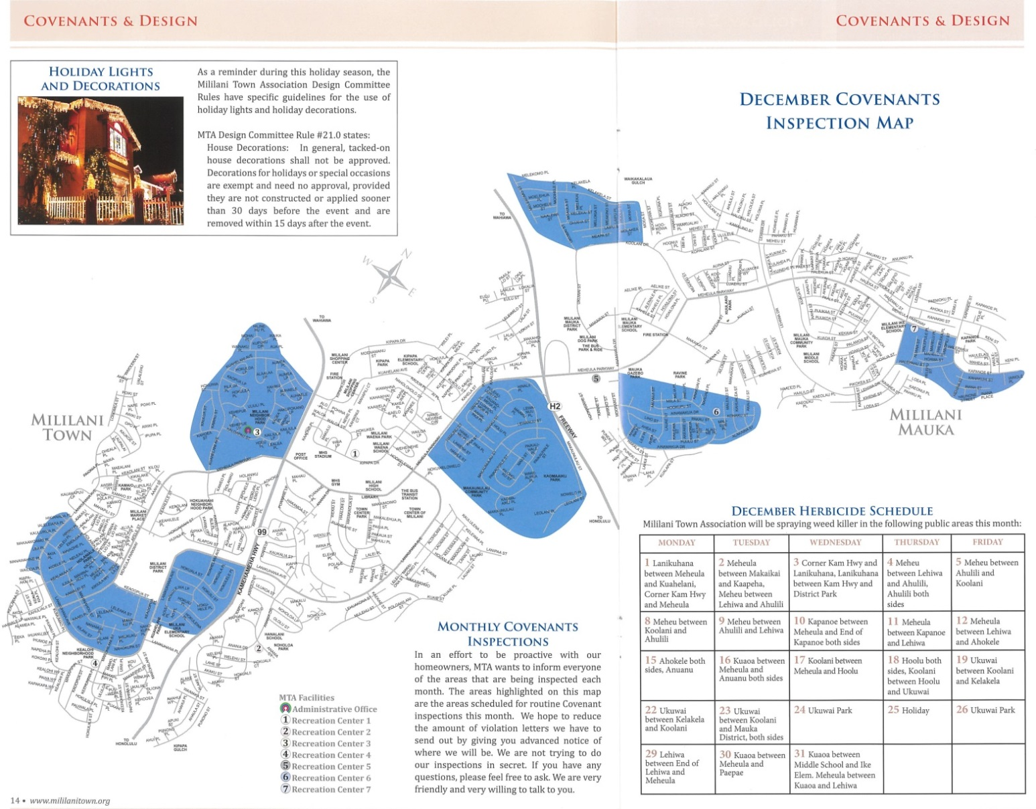
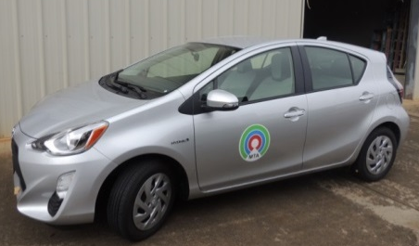
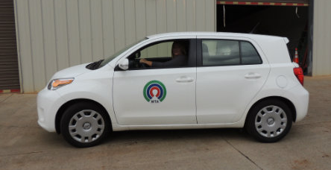
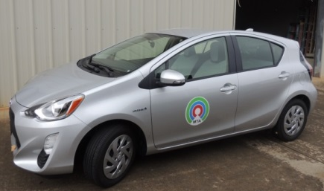
Covenants Monthly Map
Published in the MTA Newsletter monthly

Slide 24

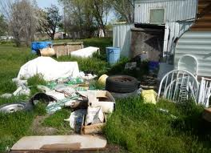
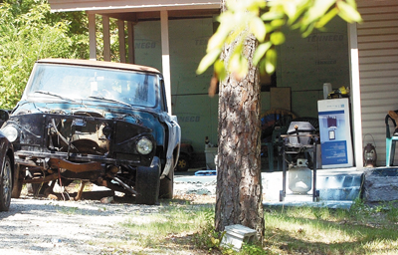

Common Violations
Overgrown Yards
Yard Storage
Disabled Vehicle
Carport Storage

Slide 25




We know it is natural to get angry and want
to yell at us…
So when you receive a letter…
But we promise we will work with you and help you through the process.

Slide 26


Yard of the Quarter
Selected by Covenants quarterly and voted on by a special panel of judges
All nominated properties are shown in our newsletter and on our website
Winner receives a cash prize from the sponsor company
Winner is featured in our MTA
Newsletter and Website

Slide 27



*To review our documents go to www.mililanitown.org under the For Residents tab and Rules and Covenants.
*To send an email directly to any departments of the Association, go to the Contact tab and click the email address and you can send it directly to them. Or you can go to the About Us tab and under the Management Team selection, you can get our direct phone numbers and email addresses to contact when you are ready.

Slide 28




Common Area
Landscaping

Slide 29



Common Area
MTA Responsibility
All MTA owned parcels
Sidewalks owned by MTA
Landscaping inside of sidewalks
Median hedges and turf

Slide 30

Common Area
Home Owner Responsibility
Home owner property including curb line

Slide 31


Common Area
City and County Responsibility
Trees within medians and curb lines
City and County sidewalks
City and County streets
Urban Forestry 808 971-9751

Slide 32
Maintenance
Our maintenance crew consists of 11 team members
They are responsible for the maintenance of all of the MTA Recreation Centers, pools, administrative building, warehouse, and equipment.
Each Recreation Center is assigned one employee who is responsible for the daily upkeep.
Two employees work nights and weekends to ensure the facilities are cleaned and ready for our patrons to use and enjoy.

Slide 33






Slide 34







Slide 35


The Rec. 7 Café, located in Mililani Mauka Recreation Center 7, opened in October 2014. Owned and operated by MTA but proudly serving Starbucks beverages. Rec. 7 Café is another great amenity for Mililani residents!

Slide 36

Rec 7 Café Hours:
95-1333 Lehiwa Drive
Open Daily: 7am – 7pm
* See facility schedule for closures and holiday hours

Slide 37








Assortment of pastries
delivered 2-3 times a week, and grab ‘n go food and snacks

Slide 38




Shave Ice
Keiki - $2.00
Small - $3.00
Large - $3.50
Add on items like
Ice Cream, Azuki Beans, mochi,
condensed milk, and li hing powder
available as well!

Slide 39





Ice Cream, Sorbet and Sherberts in a variety of flavors!
Try adding it into your shave ice for an extra special treat!
Ice cream sandwiches
and
Sundae cones also available!

Slide 40




Come and relax with a book or magazine from the lending library, watch your favorite family appropriate television show, or just sit and chat with a friend.

Slide 41



Bring your own laptop or tablet and jump on our FREE WiFi the next time you need to study or get some work done. Or feel free to use one of our 13 computers for free as well!

Slide 42






Slide 43

Loyalty Program
One FREE drink or pastry of your choice after 10 visits!
Easy to Sign Up!
Name
Email address
No punch cards or app to open, just tell us your name when you order!

Slide 44









@rec7cafe
Call in your order so we can jump start your order!
440-2609
Order and pay online so all you have to do is pick up your order!
www.rec7cafe.myncrsilver.com
Links to our online ordering website and Instagram found on the MTA website and app!

Slide 45

Come Visit us Soon!

Slide 46


Aquatics & Safety
Check the website for updated class information
Lifeguards, Swim, Water Aerobics Instructors, & Safety Program
Learn to Swim
Pre School – Level 6
Tuesday/Thursday at Rec 2
Saturday/Sundays or just Saturday or just Sunday at Rec 7
Swim Registration: Online www.mililanitown.org
Download App. WebTrac

Slide 47


Aquatics
Water Aerobics
Two types of classes:
*Low Impact/Muscle Toning
*High Impact/Cardio Workout
Check the website for updated class information

Slide 48


Aquatics
Check the website for updated class information
Special Needs Program
Children who are diagnosed on the autism spectrum or who have any disorders.
1 on 1 with an instructor for 30 minutes

Slide 49


Additional Aquatics Programs
Check the website for updated class information
Lifeguarding
Community CPR
Junior Masters Program
(noncompetitive swim team)
Adult Learn to Swim Class
One-on-One swim Lessons
Parent Aid

Slide 50

Waterslide at Rec 1

Slide 51

SPLASH PARK
NOW OPEN
HOURS OF OPERATION:
Daily: 7:00am – 7:00pm***
*** Wednesday: 12noon – 7:00pm
Don’t forget to check in and get your wristband!
** check the website for updated facility schedule.

Slide 52







7 Recreation Centers
Rec 1- Pool and Facility
Rec 2 – Pool Party
Rec 3 – Pool and Facility
Rec 5- Facility
Rec 4- Pool Party
Rec 6- Pool and Facility
Rec 7

Slide 53

aMENITIES

Slide 54
MTA Business Offices
ADMINISTRATIVE OFFICE
95-303 Kaloapau Street, Mililani, HI 96789
Tel: 808-623-7300 / Fax: 808-623-3474
8:00am to 4:30pm
Closed Weekends and Holidays
No Walk Ins / Phone Calls and Emails Only
REC CENTER 3 BUSINESS OFFICE
95-281 Kaloapau Street, Mililani, HI 96789
Tel: 808-440-2603
Daily 7:00am – 7:00pm
NO Cash Transactions
REC CENTER 7 BUSINESS OFFICE
95-1333 Lehiwa Drive, Mililani Mauka, HI 96879
Tel: 808-440-2608
Daily 7:00am – 7:00pm
NO Cash Transactions
Submit applications
Submit forms
Purchase consolidated
$8.50 Movie Tickets

Slide 55



Recreation Center 7 BBQ Pavilions
RENTAL FEE: $50/pavilion
MAXIMUM CAPACITY: 12 people
TIMES: 10am – 2pm
4pm – 8pm
Check the website for updated reservation information

Slide 56

MTA ID Cards
ONE MEMBER CARD PER HOUSEHOLD:
Only one member card is needed for the entire household
No picture on the member card ; no expiration date on card
COST:
  $6.50 per year, for the whole household
  Renewal fee: $5.00 (no new card is needed)
Replacement or extra card: $2.00 per card
Family members may take a picture of the barcode to use at the rec centers, in lieu of purchasing an extra card.
GUEST POLICY:
  Guests will be required to have a Guest Pass, good for one day only, with a fee of $10 per pass
(per individual)

Slide 57

Owner Membership Info
As new homeowners, only the owners are listed on your account.
If you would like to add your household members, please fill this Owner Membership Information form and turn it in to one of our Business Offices!

Slide 58

Special Events

Slide 59





All Star Chef Show Case
Bingo
Craft Fairs
Easter Egg Hunts
Friday Night Fever (dance)
Halloween Event
Keiki Fair
Live at MTA
Movie by the Pool
Mini Workshops
Senior Day
Snow Day
These are a few of our Special Events.
Check our website for updated
Information!!

Slide 60
Please fill out the Online Registration
Access form to gain access to WebTrac.
WebTrac is our online reservation software:
Reserve Pickleball, Tennis Courts
Reserve Lap Lanes
Facility Reservations for parties
Register for MTA Programs
( example: Swim classes, Tiny Tots)
Purchase Events Tickets
You may find this form in the New Homeowner Packet or online

Slide 61

WEBTRAC : Online Registration Software

Slide 62


Slide 63



MTA APP

Slide 64


Stay informed!
MILILANI NEWS
contact info – meetings – events
assessments – covenant maps - seminars
classes – jobs – services – facility schedules
important information – special messages
WEBSITE www.mililanitown.org
events – classes – assessment payments
newsletter archives – contact information
rec centers – café – ID card info – rules – forms
latest news
MTA APP
push notifications – updates – webrac – purchase tickets
activity signups – event information – assessment payments

Slide 65
MTA New Homeowner Packet
List of Board of Directors
Sure Pay Form
Owner Membership Information Form
Design Committee Application Form
Mililani Town Rules
Mauka and Makai Street Maps
Online Registration Access Form
City and County Honolulu : Do you Need a Building Permit
Copy of latest Newsletter

Slide 66
Mililani Town Association
We are here to help!
623-7300

